Slide 1
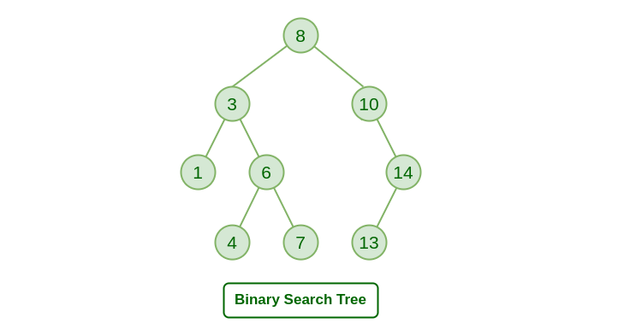
CONCEPT – Deletion in binary search tree

Slide 2
TABLE OF CONTENTS
S.NO | CONTENT | PAGE NO
01 | Introduction | 02
02 | Application of BST | 03
O3 | Reflection | 04 – 05
04 | Key findings | 06 – 07
05 | Disadvantage of BST | 08
06 | Reference | 09 - 10

Slide 3
INTRODUCTION
A binary search tree (BST), a special form of binary tree , satisfies the binary search property :
Each data value in its left subtree less than the root value.
Each data value in its right subtree greater than the root value.

Slide 4
Deletion in binary search tree
In the first case, the node to be deleted is the leaf node. In such a case, simply delete the node from the tree.
In the second case, the node to be deleted lies has a single child node. In such a case follow the steps below:
Replace that node with its child node.
Remove the child node from its original position.
In the third case, the node to be deleted has two children. In such a case follow the steps below:
Get the in-order successor of that node.
Replace the node with the in-order successor.
Remove the in-order successor from its original position.

Slide 5
APPLICATION OF BINARY SEARCH TREE
Searching: Finding a specific element in a sorted collection
Sorting: Sorting a collection of elements in ascending or descending order
Range queries: Finding elements within a specified range
Data storage: Storing and retrieving data in a hierarchical manner
Databases: Indexing data for efficient retrieval
Computer graphics: Representing spatial data in a tree structure
Artificial intelligence: Decision trees and rule-based systems

Slide 6
REFLECTION
As a team of five members , our goal is to make people aware about the binary search tree ,properties of binary search tree , how we can do deletion in binary search tree and different cases of deletion , how we can do searching in binary search tree .
Every member of our team made a contribution to achieve this objective .
Sakshi – GitHub , Mail
Nancy - Presentation
Khushi - Report

Slide 7
4. Ritu - Presentation 5. Muskan - Report

Slide 8
KEY FINDINGS
Locating the node to be deleted .
Handling different cases based on the number of children the node has (0,1,2) .
Maintaining the binary tree properties after deletion (e.g., maintaining the binary search tree property) .
Adjusting pointers and reorganizing the tree structure as needed .
Handling edge cases , such as deleting the root node or a leaf node .

Slide 9
CONCLUSION
Efficient searching: O(log n) time complexity for searching
Ordered structure: Elements are stored in sorted order, making it easy to find the next or previous element
Dynamic insertion and deletion: Elements can be added or removed efficiently
Balanced structure: Balanced BSTs maintain a logarithmic height, ensuring efficient operations
Space efficiency: BSTs store only the key values, making them space-efficient

Slide 10
DISADVANTAGE OF BINARY SEARCH TREE
Not self-balancing: Unbalanced BSTs can lead to poor performance
Worst-case time complexity: In the worst case, BSTs can have a linear time complexity for searching and insertion
Memory overhead: BSTs require additional memory to store pointers to child nodes
Not suitable for large datasets: BSTs can become inefficient for very large datasets
Limited functionality: BSTs only support searching, insertion, and deletion operations

Slide 11
REFERENCES
[1] “what is binary search tree” – definition , properties of bst
https://www.programiz.com/dsa/binary-search-tree
[2] “Deletion in binary search tree”
https://leetcode.com/explore/learn/card/introduction-to-data-structure-binary-search-tree/141/basic-operations-in-a-bst/
[3] “Algorithm for case I,II,III Deletion in binary search tree
Sushil Goel book
[4] “searching in binary search tree”
https://www.programiz.com/dsa/binary-search-tree

Slide 12
[5] “Algorithm for searching in binary search Tree” Sushil Goel book [6] “deletion in algorithm” Sushil Goel book

